Slide 1
Concurrency Control

Slide 2
Concurrent Executions
Multiple transactions are allowed to run concurrently in the system.
Advantages are:
increased processor and disk utilization, leading to better transaction throughput (Speed of database)
E.g. one transaction can be using the CPU while another is reading from or writing to the disk
reduced average response time for transactions: short transactions need not wait behind long ones.
Concurrency control schemes – mechanisms to achieve isolation that is, to control the interaction among the concurrent transactions in order to prevent them from destroying the consistency of the database

Slide 3
Potential Problems of Concurrency
The Lost Update Problem
This occurs when two transactions that access the same database items have their operations interleaved in a way that makes the value of some database item incorrect.
The Temporary Update (or Dirty Read) Problem
This occurs when one transaction updates a database item and then the transaction fails for some reason
The updated item is accessed by another transaction before it is changed back to its original value.
The Incorrect Summary Problem
If one transaction is calculating an aggregate summary function on a number of records while other transactions are updating some of these records, the aggregate function may calculate some values before they are updated and others after they are updated.

Slide 4
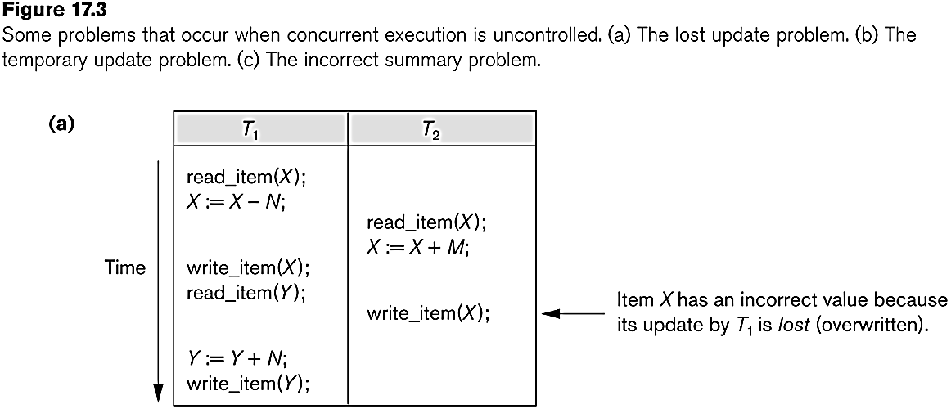
Concurrent execution is uncontrolled: (a) The lost update problem.

Slide 5
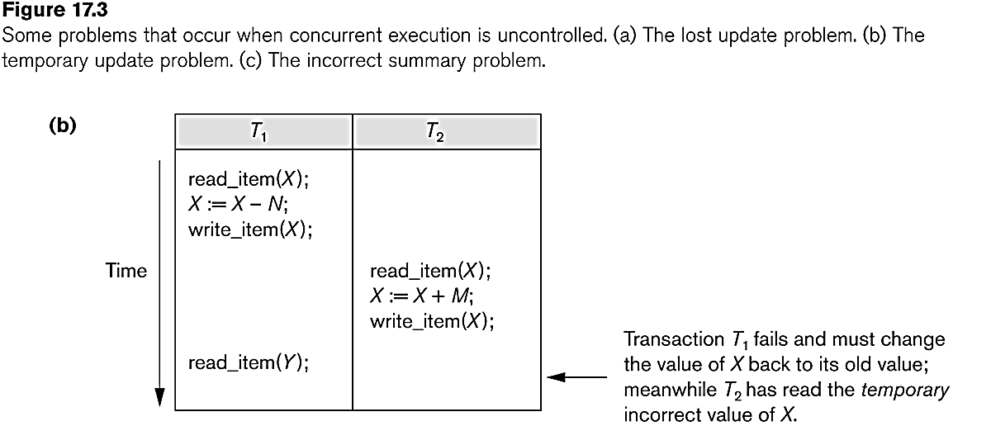
Concurrent execution is uncontrolled: (b) The temporary update problem.

Slide 6
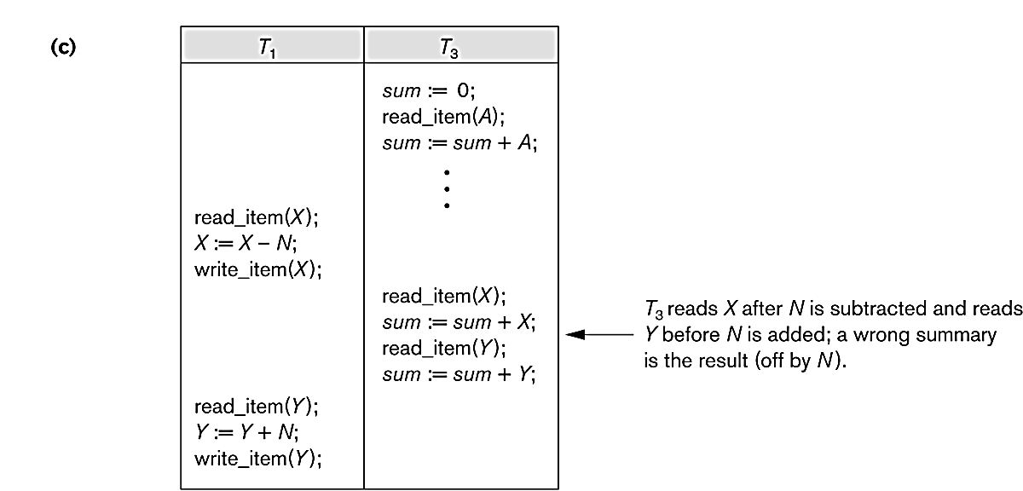
Concurrent execution is uncontrolled: (c) The incorrect summary problem.

Slide 7
Why use Concurrency method?
To apply Isolation through mutual exclusion between conflicting transactions
To resolve read-write and write-write conflict issues
To preserve database consistency through constantly preserving execution obstructions
The system needs to control the interaction among the concurrent transactions. This control is achieved using concurrent-control schemes.
Concurrency control helps to ensure serializability

Slide 8
Example
Assume that two people who go to electronic kiosks at the same time to buy a movie ticket for the same movie and the same show time.
However, there is only one seat left in for the movie show in that particular theatre. Without concurrency control, it is possible that both moviegoers will end up purchasing a ticket.
However, concurrency control method does not allow this to happen. Both moviegoers can still access information written in the movie seating database.
But concurrency control only provides a ticket to the buyer who has completed the transaction process first.

Slide 9
Concurrency Control
Concurrency control mechanism is responsible for maintaining the database consistency in case of concurrent execution.
Following are the most common concurrency control protocols:
Lock based protocol
Graph Based protocol
Time stamp based protocol
Validation based protocol

Slide 10
Lock-Based Protocols
Inconsistency occurs when two transactions attempt to modify the same data item at the same time.
A general solution to this problem is that, if one transaction is accessing a data item then, no other transaction should be allowed to modify that data item.
Locks are used to implement this general solution.
Lock- is a variable associated with each data item that describes the status of the item with respect to possible operations that can be applied to it.

Slide 11
Locks
There are two types of locks:
Binary locks
Shared/Exclusive locks
A binary lock can have two states-locked and unlocked.
The function lock(X) tells that whether data item X is locked or not at a given time.
If lock(X)=1 then, X is locked and if lock(X)=0 then, X is not locked.
A transaction can request and release a lock on data item X by using following two instructions:
Lock_item(X)
unlock_item(X)

Slide 12
Locks
Main drawback of binary lock is that at a given point of time, at most one transaction can hold a lock on data item X. But, in database system it should be allowed that multiple transactions may access a data item only for reading.
To overcome this problem, we use shared/exclusive lock.

Slide 13
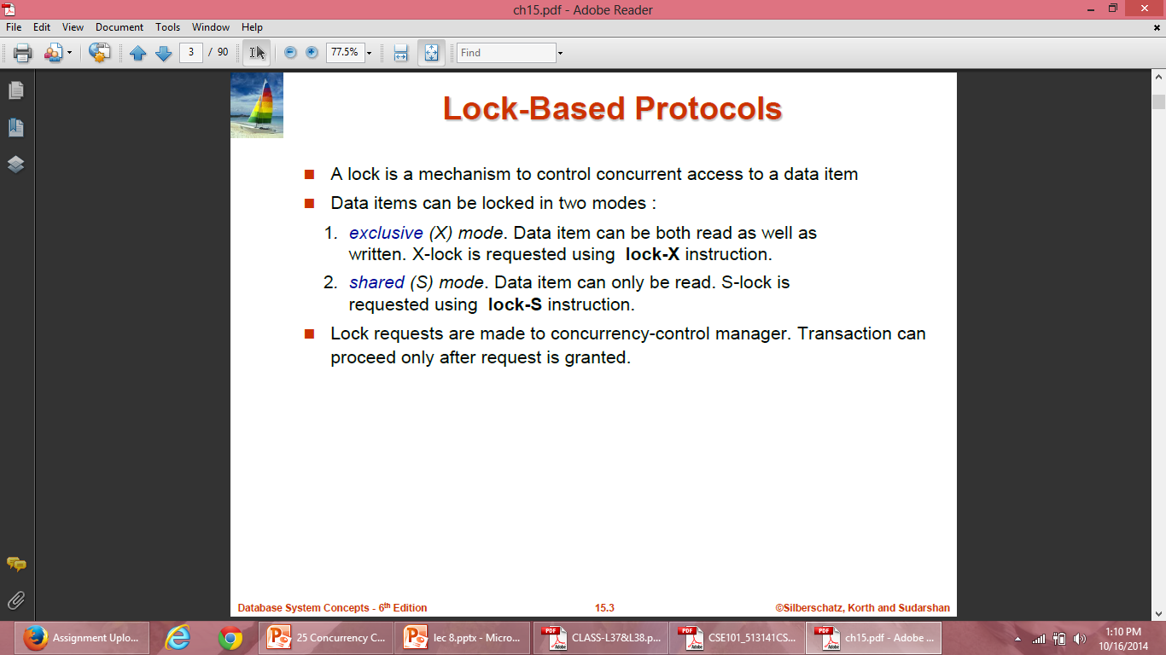
Locks

Slide 14
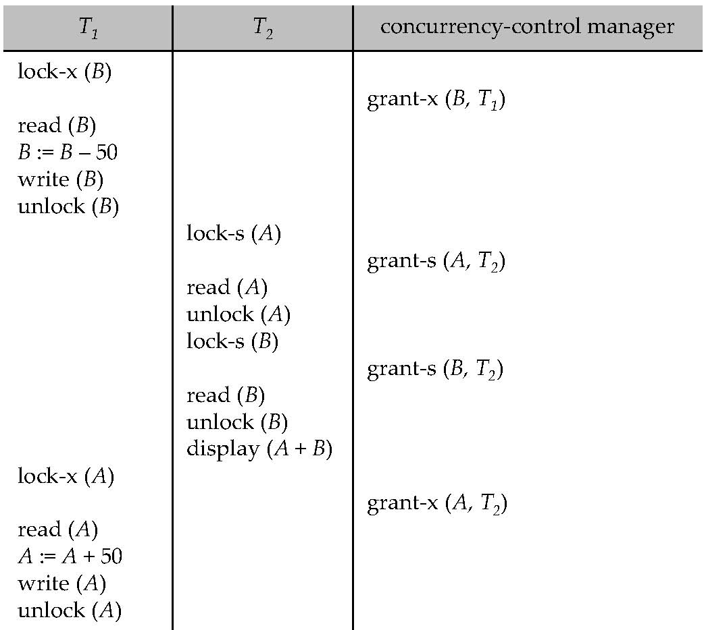
Locks

Slide 15
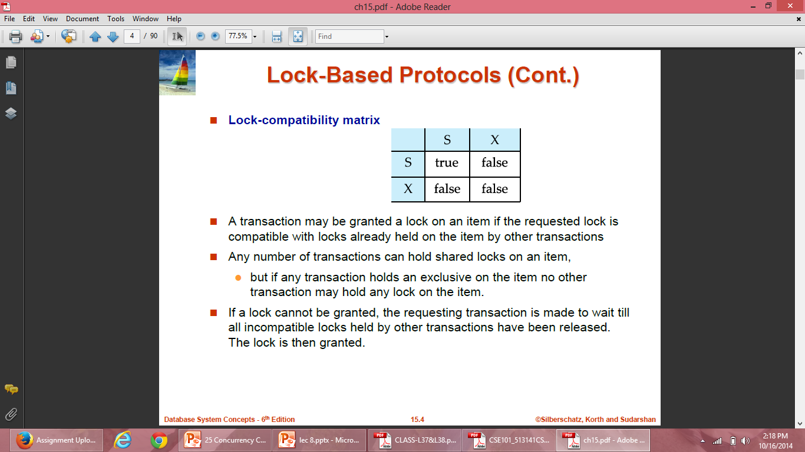
Compatibility Function
Compatibility function can be defined as:
Let M and N be two lock modes. Now suppose that a transaction Ti requests a lock of mode M on data item A on which transaction Tj currently holds a lock of mode N. If transaction Ti can be granted a lock on A immediately inspite of presence of lock of mode N, then mode M is said to be compatible with mode N.

Slide 16
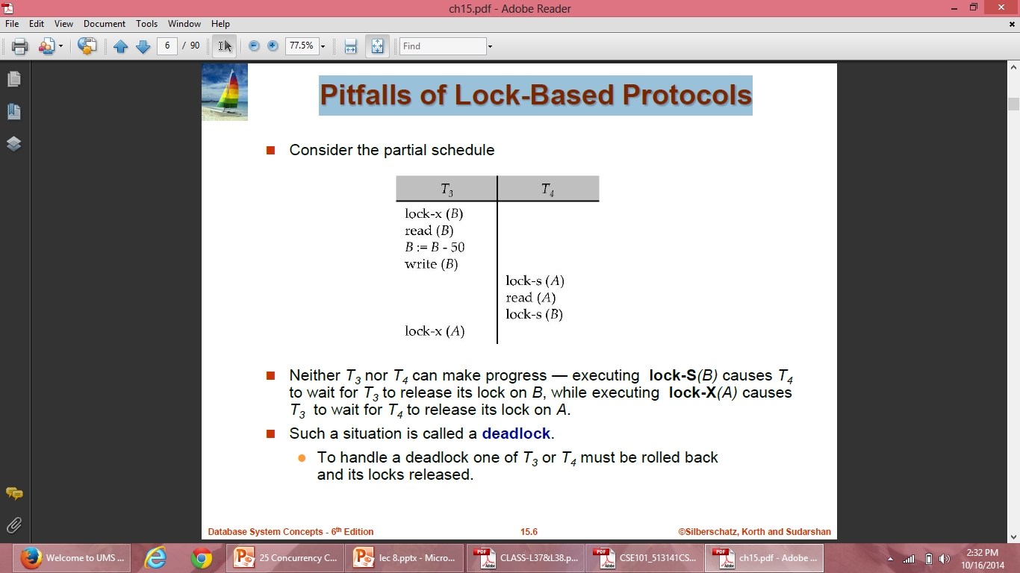
Pitfalls of Lock-Based Protocols
Notes:
We have arrived a state where neither of the transactions can ever proceed with normal execution. This situation is called deadlock

Slide 17
Pitfalls of Lock-Based Protocols
Starvation is the situation when a transaction has to wait for a indefinite period of time to acquire a lock.
Starvation is also possible if concurrency control manager is badly designed. For example: A transaction may be waiting for an X-lock on an item, while a sequence of other transactions request and are granted an S-lock on the same item.
The same transaction is repeatedly rolled back due to deadlocks.
Concurrency control manager can be designed to prevent starvation.

Slide 18
Starvation- Example
Starvation can be best explained with the help of an example –
Suppose there are 3 transactions namely T1, T2, and T3 in a database that are trying to acquire a lock on data item ‘ I ‘ .
Now, suppose the scheduler grants the lock to T1(may be due to some priority), and the other two transactions are waiting for the lock.
As soon as the execution of T1 is over, another transaction T4 also come over and request lock on data item I.
Now, this time the scheduler grants lock to T4, and T2, T3 has to wait again .
In this way if new transactions keep on requesting the lock, T2 and T3 may have to wait for an indefinite period of time, that leads to Starvation.

Slide 19
Lock-Based Protocols
A locking protocol is a set of rules followed by all transactions while requesting and releasing locks. Locking protocols restrict the set of possible schedules.
Two types of lock based protocol is:
Two-phase locking protocol
Protocol which is not two phase:
Graph based protocol

Slide 20
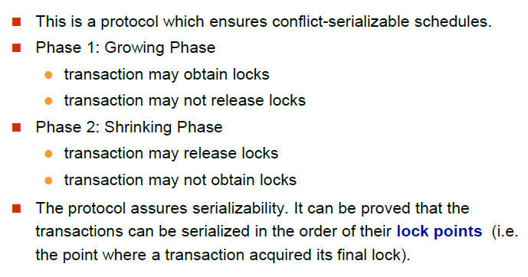
The Two-Phase Locking Protocol

Slide 21
Advantage of 2PL
Ensures serailizability

Slide 22
Disadvantages
May not free from irrecoverability
Not Free from deadlocks
Not free from starvation
Not free from cascading rollback

Slide 23
The Two-Phase Locking Protocol
Cascading rollback may occur in Two phase locking so in order to avoid it three variations on two phase locking is used:
Strict two-phase locking : Here a transaction must hold all its exclusive locks till it commits/aborts.
Rigorous two-phase locking : is even stricter: here all locks are held till commit/abort. In this protocol transactions can be serialized in the order in which they commit.
Two phase locking with Lock Conversion: This protocol adds the ability of lock conversion to the basic two phase locking. i.e we can convert a shared lock to an exclusive lock and vice versa. The Upgrade(A) instruction is used to convert a shared lock to an exclusive lock. The Downgrade(A) instruction is used to convert an exclusive lock shared lock.

Slide 24
Graph Based Protocol
Graph-based protocols are an alternative to two-phase locking
If we wish to develop lock based protocol that is not based on 2Phase need additional information that how each transaction will access the data.
This protocol requires prior knowledge about the order in which database items will be accessed
To acquire such prior knowledge, we impose a partial ordering→ on the set D = {d1, d2 ,..., dh} of all data items.
If di → dj then any transaction accessing both di and dj , di must access before accessing dj.

Slide 25
Graph Based Protocol
A tree or a graph protocol only exclusive locks are allowed. Each transaction Ti can lock data item only once, and must observe the following rules:
The first lock by Ti can be acquired on any data item.
Subsequently, a data Q can be locked by Ti only if the parent of Q is currently locked by Ti.
Data items may be unlocked at any time.
A data item that has been locked and unlocked by Ti cannot subsequently be relocked by Ti

Slide 26
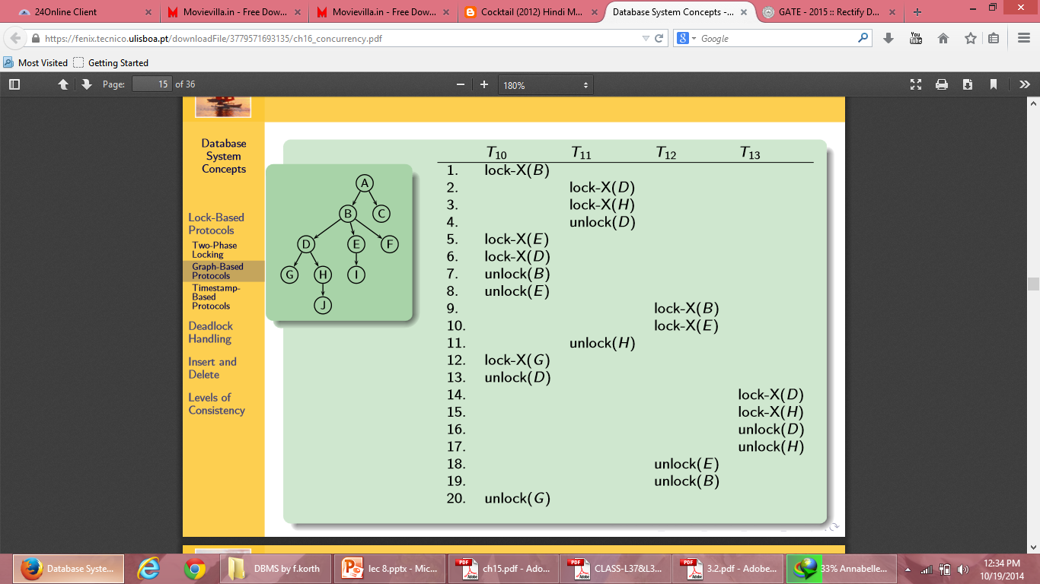
Graph Based Protocol: Example

Slide 27
Graph Based Protocol
Advantages:
The tree protocol ensures conflict serializability as well as freedom from deadlock.
Unlocking may occur earlier in the tree-locking protocol than in the two-phase locking protocol.
shorter waiting times, and increase in concurrency
protocol is deadlock-free, no rollbacks are required
Disadvantages:
Prior Knowledge of data
Unnecessary locks

Slide 28
Time Stamp Based Protocol
Each transaction is issued a timestamp when it enters the system. If an old transaction Ti has time-stamp TS(Ti), a new transaction Tj is assigned time-stamp TS(Tj) such that TS(Ti) <TS(Tj).
The protocol manages concurrent execution such that the time-stamps determine the serializability order.
In order to assure such behavior, the protocol maintains for each data Q two timestamp values:
W-timestamp(Q) is the largest timestamp of any transaction that executed write(X) successfully.
R-timestamp(Q) is the largest timestamp of any transaction that executed read(X) successfully.

Slide 29
Time Stamp Based Protocol
Use the value of the system clock as the timestamp; that is, a transaction’s timestamp is equal to the value of the clock when the transaction enters the system.
Use a logical counter that is incremented after a new timestamp has been assigned; that is, a transaction’s timestamp is equal to the value of the counter when the transaction enters the system.

Slide 30
Time Stamp Based Protocol
The timestamp ordering protocol ensures that any conflicting read and write operations are executed in timestamp order.
Suppose a transaction Ti issues a read(Q)
If TS(Ti) < W-timestamp(Q), then Ti needs to read a value of Q that was already overwritten. Hence, the read operation is rejected, and Ti is rolled back.
If TS(Ti)> W-timestamp(Q), then the read operation is executed, and R-timestamp(Q) is set to max(R-timestamp(Q), TS(Ti)).

Slide 31
Ti=Read Q
TS(T1)<= W-timestamp(Q)
Eg: TS(T1)=9:00:00 data item Q=1000
W-timestamp=9:00:01 data item Q=1100 by T2
When T1 issues read operation, the value of Q at 9:00:00 will be read, which is already updated by T2 to 1100 at 9:00:01. The value which T1 is going to read will be incorrect. . Hence, read operation of T1 will be rejected.

Slide 32
Ti=Read Q
TS(T1)>= W-timestamp(Q)
Eg: W-timestamp=9:00 data item Q=1100
TS(T1)=9:05
When T1 issues read operation, the value of Q updated recently will be read, which will be the correct value. Hence, read operation of T1 will be executed.

Slide 33
Time Stamp Based Protocol
Suppose that transaction Ti issues write(Q).
If TS(Ti) < R-timestamp(Q), then the value of Q that Ti is producing was needed previously, and the system assumed that that value would never be produced. Hence, the write operation is rejected, and Ti is rolled back.
If TS(Ti) < W-timestamp(Q), then Ti is attempting to write an obsolete value of Q. Hence, this write operation is rejected, and Ti is rolled back.
Otherwise, the write operation is executed, and W-timestamp(Q) is set to TS(Ti).

Slide 34
Rules:
Transaction Ti issues a Read(Q) operation
If WTS(Q)>TS(Ti), Rollback Ti.
Otherwise execute R(Q) operation
Set RTS(Q) =Max{RTS(Q), TS(Ti)}
2. Transaction Ti issues Write(Q) operation
If RTS(Q)>TS(Ti) then Roll Back Ti.
If WTS(Q)>TS(Ti) then Roll Back Ti.
Otherwise execute Write(Q) operation
Set WTS(Q)=TS(Ti).
T1 | T2 | T3
R(A)
 | R(B)
W(C)
 |  | R(B)
R(C)
 | W(B)
 |  | W(A)
 | A | B | C
RTS | 0 | 0 | 0
WTS | 0 | 0 | 0

Slide 35
Ti=Write Q
TS(T1)<=R-timestamp(Q)
Eg: TS(T1)=9:00:00
R-timestamp=9:00:01 by T2
When T1 issues write operation, the value of Q which is going to be written by T1 will not be used now, because T2 has already read the previous value of Q at 9:00:01 before it was updated by T1. Hence, write operation of T1 will be rejected.

Slide 36
Ti=Write Q
TS(T1)<= W-timestamp(Q)
Eg: TS(T1)=9:00:00
W-timestamp=9:00:01 by T2
When T1 issues write operation, the value of Q which is going to be written by T1 will not be used now, because T2 has already written a new value of Q at 9:00:01 before it was written by T1. Hence, write operation of T1 will be rejected.

Slide 37
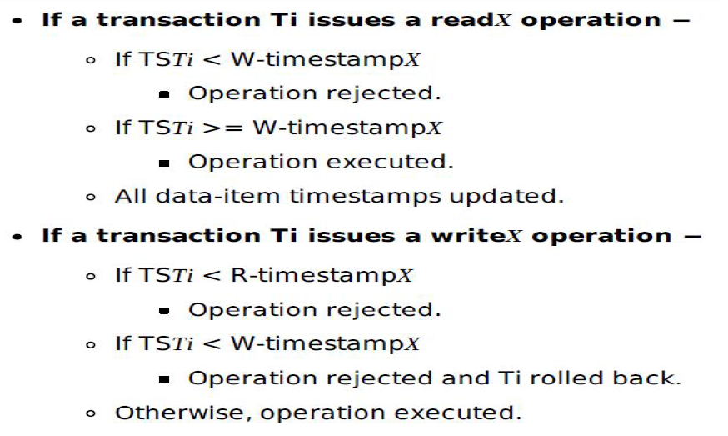

Slide 38
Time Stamp Based Protocol: Example
To illustrate this protocol, we consider transactions T₁ and T₂. Transaction T₁ displays the contents of accounts A and B:
T₁:
read(B);
read(A);
display(A + B);
T₂:
read(B);
B := B − 50;
write(B);
read(A);
A := A + 50;
write(A);
display(A + B);

Slide 39
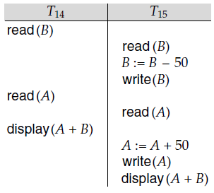
Time Stamp Based Protocol
In presenting schedules under the timestamp protocol, we shall assume that a transaction is assigned a timestamp immediately before its first instruction. Thus, in schedule 3, TS(T₁) < TS(T₂), and the schedule is possible under the timestamp protocol.
Schedule 3

Slide 40
Validation Based Protocol
We assume that each transaction T_{i} executes in two or three different phases in its lifetime, depending on whether it is a read-only or an update transaction. The phases are, in order,
Read phase(Execution Phase). During this phase, the system executes transaction T_{i}. It reads the values of the various data items and stores them in temporary variables (local variable of T_{i)}. It performs all write operations on temporary local variables, without updates of the actual database.

Slide 41
Validation Based Protocol
Validation phase. Transaction T_{i} performs a validation test to determine whether it can be copied to the database from the temporary local variables that hold the results of write operations without causing any violation of serializability.
Write phase. If transaction T_{i} succeeds in validation (step 2), then the system applies the actual updates to the database. Otherwise, the system rolls back T_{i}.

Slide 42
Validation Based Protocol
Each transaction Ti has 3 timestamps
Start(Ti) : the time when Ti started its execution
Validation(Ti): the time when Ti finishes its start phase and entered into its validation phase
Finish(Ti) : the time when Ti finished its write phase
We determine the serializability only by time stamp ordering technique using the values of timestamp validation(Ti). Thus value TS(Ti)=validation(Ti)

Slide 43
To clear all the validation test by Ti, then Ti must satisfy one of the following condition:
1. Finish(Ti)<Start(Tj)- It means Ti is older transaction & it gets finished before Tj starts.(No Overlap). Serializability maintains. Validation test pass.
2. Finish(Ti)<Validate(Tj)- This ensures actual write by Ti and Tj will not overlap.
3. Validate(Ti) < Validate(Tj) It ensures that Ti has confirmed Read phase before Tj completes Read phase.

Slide 44
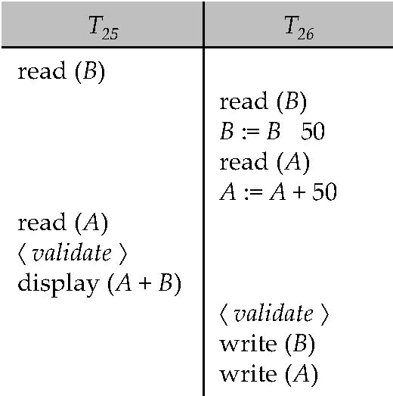

Slide 45
Advantages
Maintains Serializability
Avoid cascading Rollback
Avoid Deadlocks
Disadvantages
Starvation of long transactions due to conflicting transactions

